Slide 1
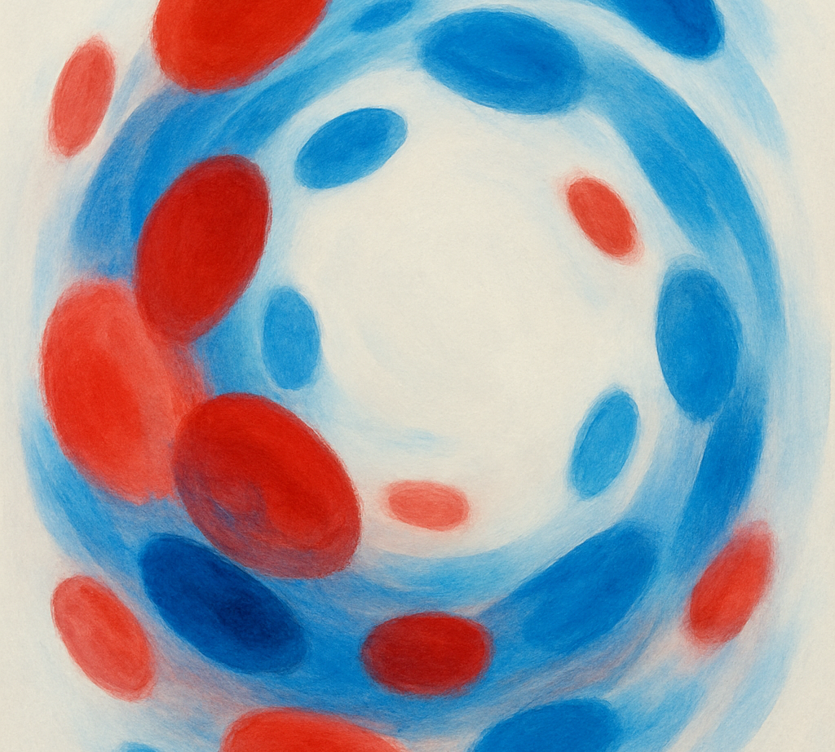
How to Access Reliable Research
Evidence‑Based Diagnosis for Sarah Redrum
Starter Question – What is Sarah’s most probable disease ?
20 Oct 2025

Slide 2
Learning Objectives
Evaluate the reliability of sources and information
Use Google Scholar effectively to discover peer‑reviewed literature
Search PubMed for high‑quality medical evidence
Understand the strengths & limitations of AI tools for research
Cite sources accurately using Harvard referencing
Apply these skills to support Sarah’s differential diagnosis

Slide 3
Sarah’s Case & Research Needs
Sarah’s fall was followed by fatigue and dark, cloudy urine. Blood tests revealed anaemia (RBC count 3.8 ×10⁶/µL) and low haematocrit (34%).
Midstream urinalysis showed concentrated, alkaline urine with proteinuria, glucosuria, ketonuria, positive nitrite and leukocyte esterase, haematuria and pyuria.
These findings raise concerns about kidney bleeding, a urinary tract infection and uncontrolled type II diabetes. To interpret them correctly we must consult reliable research.
Parameter | Sarah | Reference | Interpretation
RBC count (×10⁶/µL) | 3.8 | 4.2–5.4 | Low – anaemia
Haematocrit (%) | 34 | 36–44 | Low – anaemia
Specific gravity | 1.035 | 1.005–1.03 | Concentrated
Glucose | 4+ / positive | Negative | Glucosuria (diabetes)
Nitrite & leukocyte esterase | Positive | Negative | UTI (infection)
RBCs per hpf | 12 | ≤2 | Hematuria (kidney bleeding)
WBCs per hpf | 30 | 0–4 | Pyuria (inflammation)
[1] [2] [3]

Slide 4
Can we always trust what we ‘read’?
Move around the classroom and using post it notes rank the sources in terms of trustfulness for medical / scientific information.
Include a reason for your number 1 (most trustworthy) and number 6 (least trustworthy).
[4]
Notes:
Moving around the classroom to put comments on poster paper

Slide 5


Reddit

Slide 6
Reddit
6
1

Slide 9


Slide 11
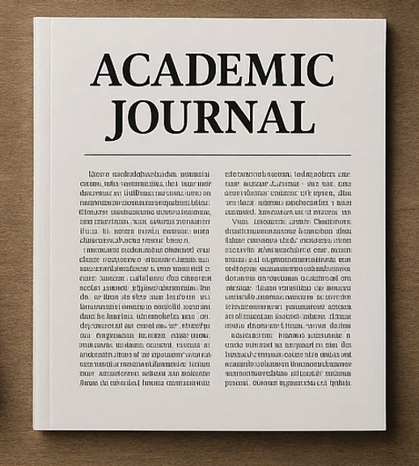

Slide 12


Slide 13
Reddit

Slide 14
Reddit

Slide 15
Evaluating Source Reliability
• Use peer‑reviewed journals, academic books and authoritative databases
• Check author credentials and institutional affiliations
• Evaluate purpose & scope – is the source scholarly or promotional?
• Assess currency – prefer recent evidence for medical decisions
• Cross‑check information across multiple reputable sources
[4]

Slide 16
Bad Science
Which of the aforementioned points (below) and which additional further points about source reliability does Dr Ben Goldacre make in his TED Talk?
Notes:
Moving around the classroom to put comments on poster paper

Slide 17
Bad Science & Critical Appraisal
• Daily health news can be misleading – question the evidence
• Ben Goldacre shows how evidence can be distorted at high speed
• Distortion ranges from obvious nutrition claims to subtle pharmaceutical tricks
• Evaluate study design, look for biases and publication suppression
• Critical thinking protects against bad science and supports evidence‑based practice
[17]

Slide 18
Learning Objectives
Evaluate the reliability of sources and information
Use Google Scholar effectively to discover peer‑reviewed literature
Search PubMed for high‑quality medical evidence
Understand the strengths & limitations of AI tools for research
Cite sources accurately using Harvard referencing
Apply these skills to support Sarah’s differential diagnosis

Slide 19

How do we find this reliable research?
?
Notes:
Moving around the classroom to put comments on poster paper

Slide 20
Using Google Scholar
• Indexes peer‑reviewed journals, theses, conference papers & books
• Use the date filter to focus on recent research
• Explore "Cited by" to track influence and "Related articles" for similar studies
• Set library links to access full‑text articles via your institution
• Verify results with other databases and watch for paywalls
[5] [6] [7]

Slide 21
Using PubMed
• Covers >30 million biomedical records (MEDLINE & more)
• Filter by free (open source) articles and start with review papers.
• Use field tags like [tiab] (title/abstract) and Boolean operators (AND, OR, NOT)
• Combine search terms via the Advanced Search interface
• Apply filters for article type, date and language; avoid limiting to full text unless necessary
• Filters restrict results to MeSH‑indexed articles – be cautious with narrow filtering
[8] [9] [10]

Slide 22
Using AI Tools in Research
• Natural‑language search doesn’t require complex Boolean logic
• AI can summarise articles and identify relevance quickly
• Export results directly to citation managers
• Limitations: accuracy depends on training data; risk of hallucinations & hidden paywalls
• Incorrect citations and black‑box algorithms compromise reproducibility
• Always verify AI‑generated recommendations against primary sources
[11] [12]

Slide 23
Learning Objectives
Evaluate the reliability of sources and information
Use Google Scholar effectively to discover peer‑reviewed literature
Search PubMed for high‑quality medical evidence
Understand the strengths & limitations of AI tools for research
Cite sources accurately using Harvard referencing
Apply these skills to support Sarah’s differential diagnosis

Slide 24
Referencing & Citations
• Harvard style uses in‑text citations (author & year) with page numbers for quotations
• Up to three authors are named; four or more become et al.
• Reference list arranged alphabetically with full publication details
• Do not cite generative AI as a source – treat it as software and describe how it was used
• Include the prompt and algorithm if AI output is reproduced in an appendix
[13] [14] [15] [16]

Slide 25
Learning Objectives
Evaluate the reliability of sources and information
Use Google Scholar effectively to discover peer‑reviewed literature
Search PubMed for high‑quality medical evidence
Understand the strengths & limitations of AI tools for research
Cite sources accurately using Harvard referencing
Apply these skills to support Sarah’s differential diagnosis

Slide 26
Summary & Reflection
• Accurate diagnosis demands reliable, up‑to‑date evidence
• Evaluate source quality and choose peer‑reviewed research
• Use Google Scholar and PubMed thoughtfully and refine searches
• AI tools can assist but must be used critically and verified
• Cite all sources properly to maintain academic integrity
• Apply these skills to interpret Sarah’s results and inform further tests
[4] [5] [8] [11] [13] [16]

